Slide 1
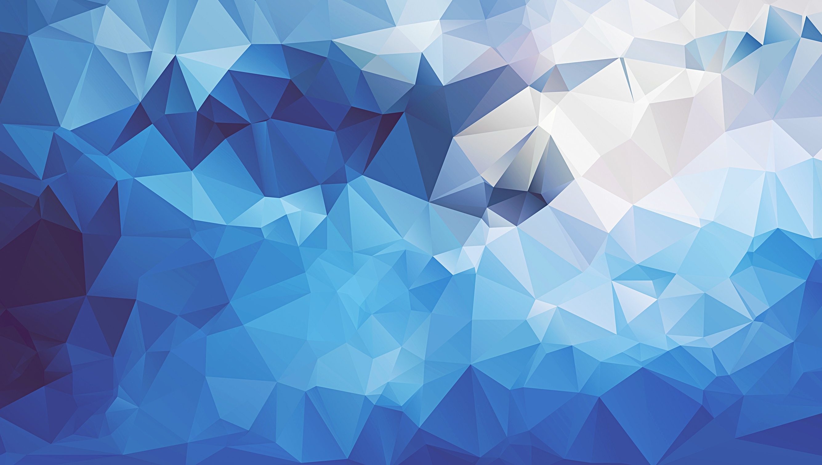
Landscape Neural Style Transfer
Rosie Zhao

Slide 2
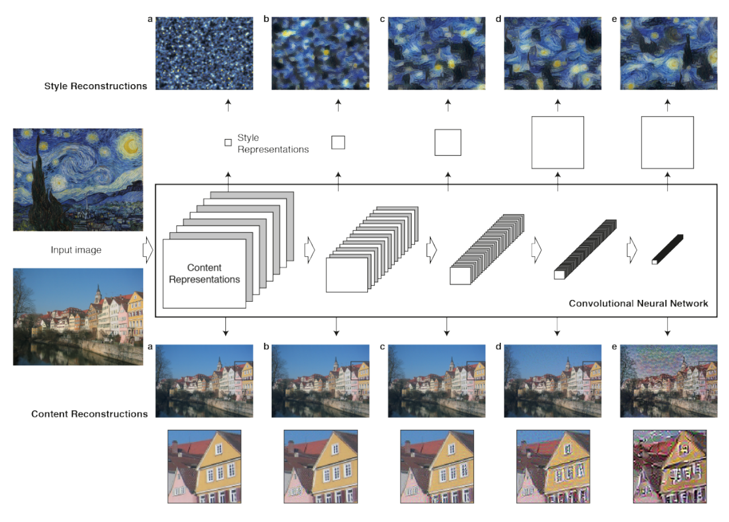
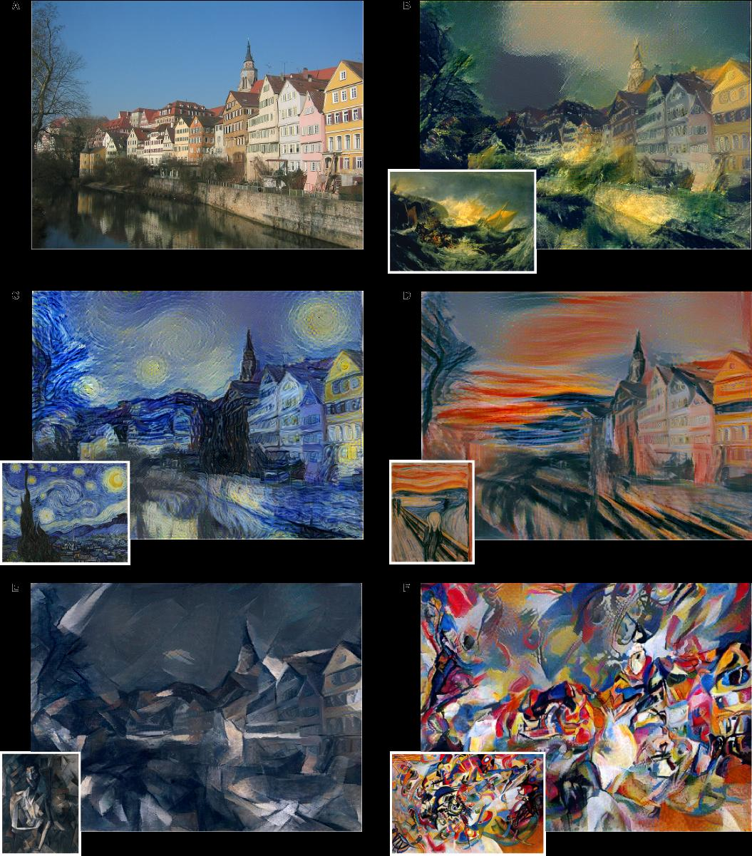
A Neural Algorithm of Artistic Style
Gatys et al. (2015) implementation
Pretrained VGG-19 network with convolutional layers extracted to work on content/style separately
Define two loss functions for content/style

Slide 3
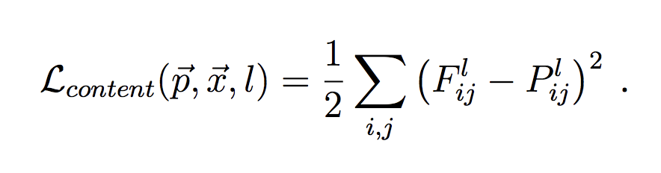
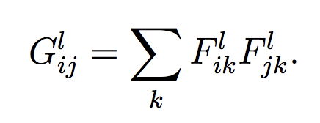
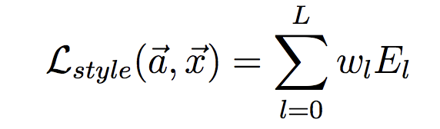
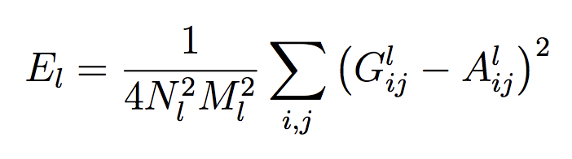
A Neural Algorithm of Artistic Style
Content Representation: Feature Maps
Style Representation: Gram Matrix of Feature Vectors

Slide 4
Personal Model Implementation
Pytorch implementation after original Gatys et al. paper
Specifically transferring the art style of Studio Ghibli, Japanese animation studio
Clear edges and smooth imaging- non-texturized compared to other traditional artwork
Cartoon style transfer aids the painstaking process of high-quality scene reproductions

Slide 5
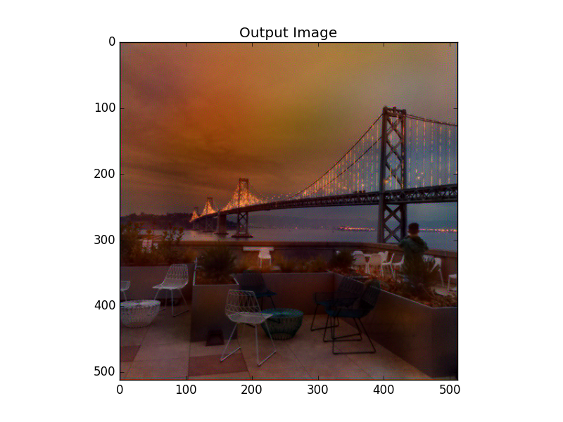
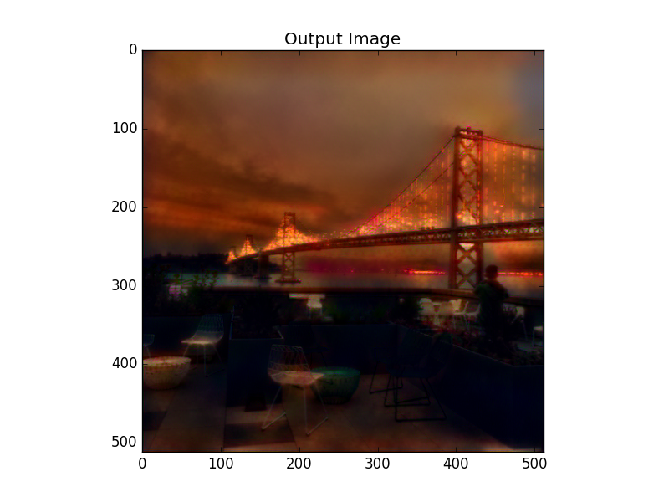
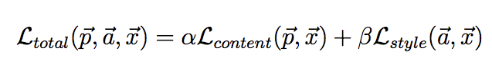
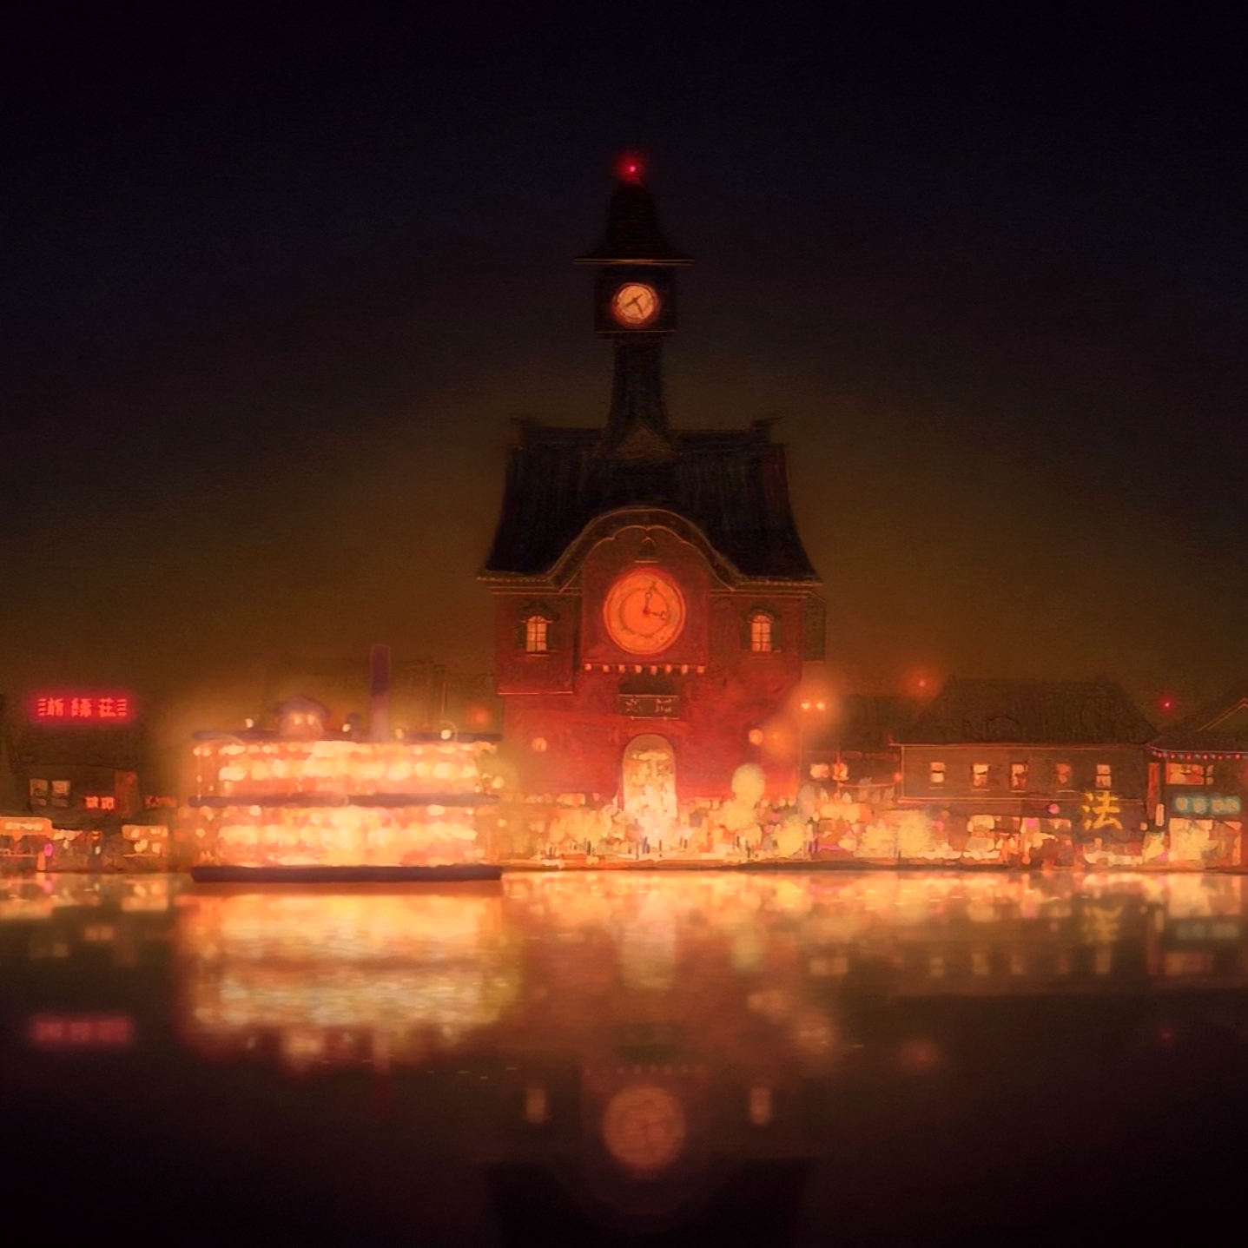
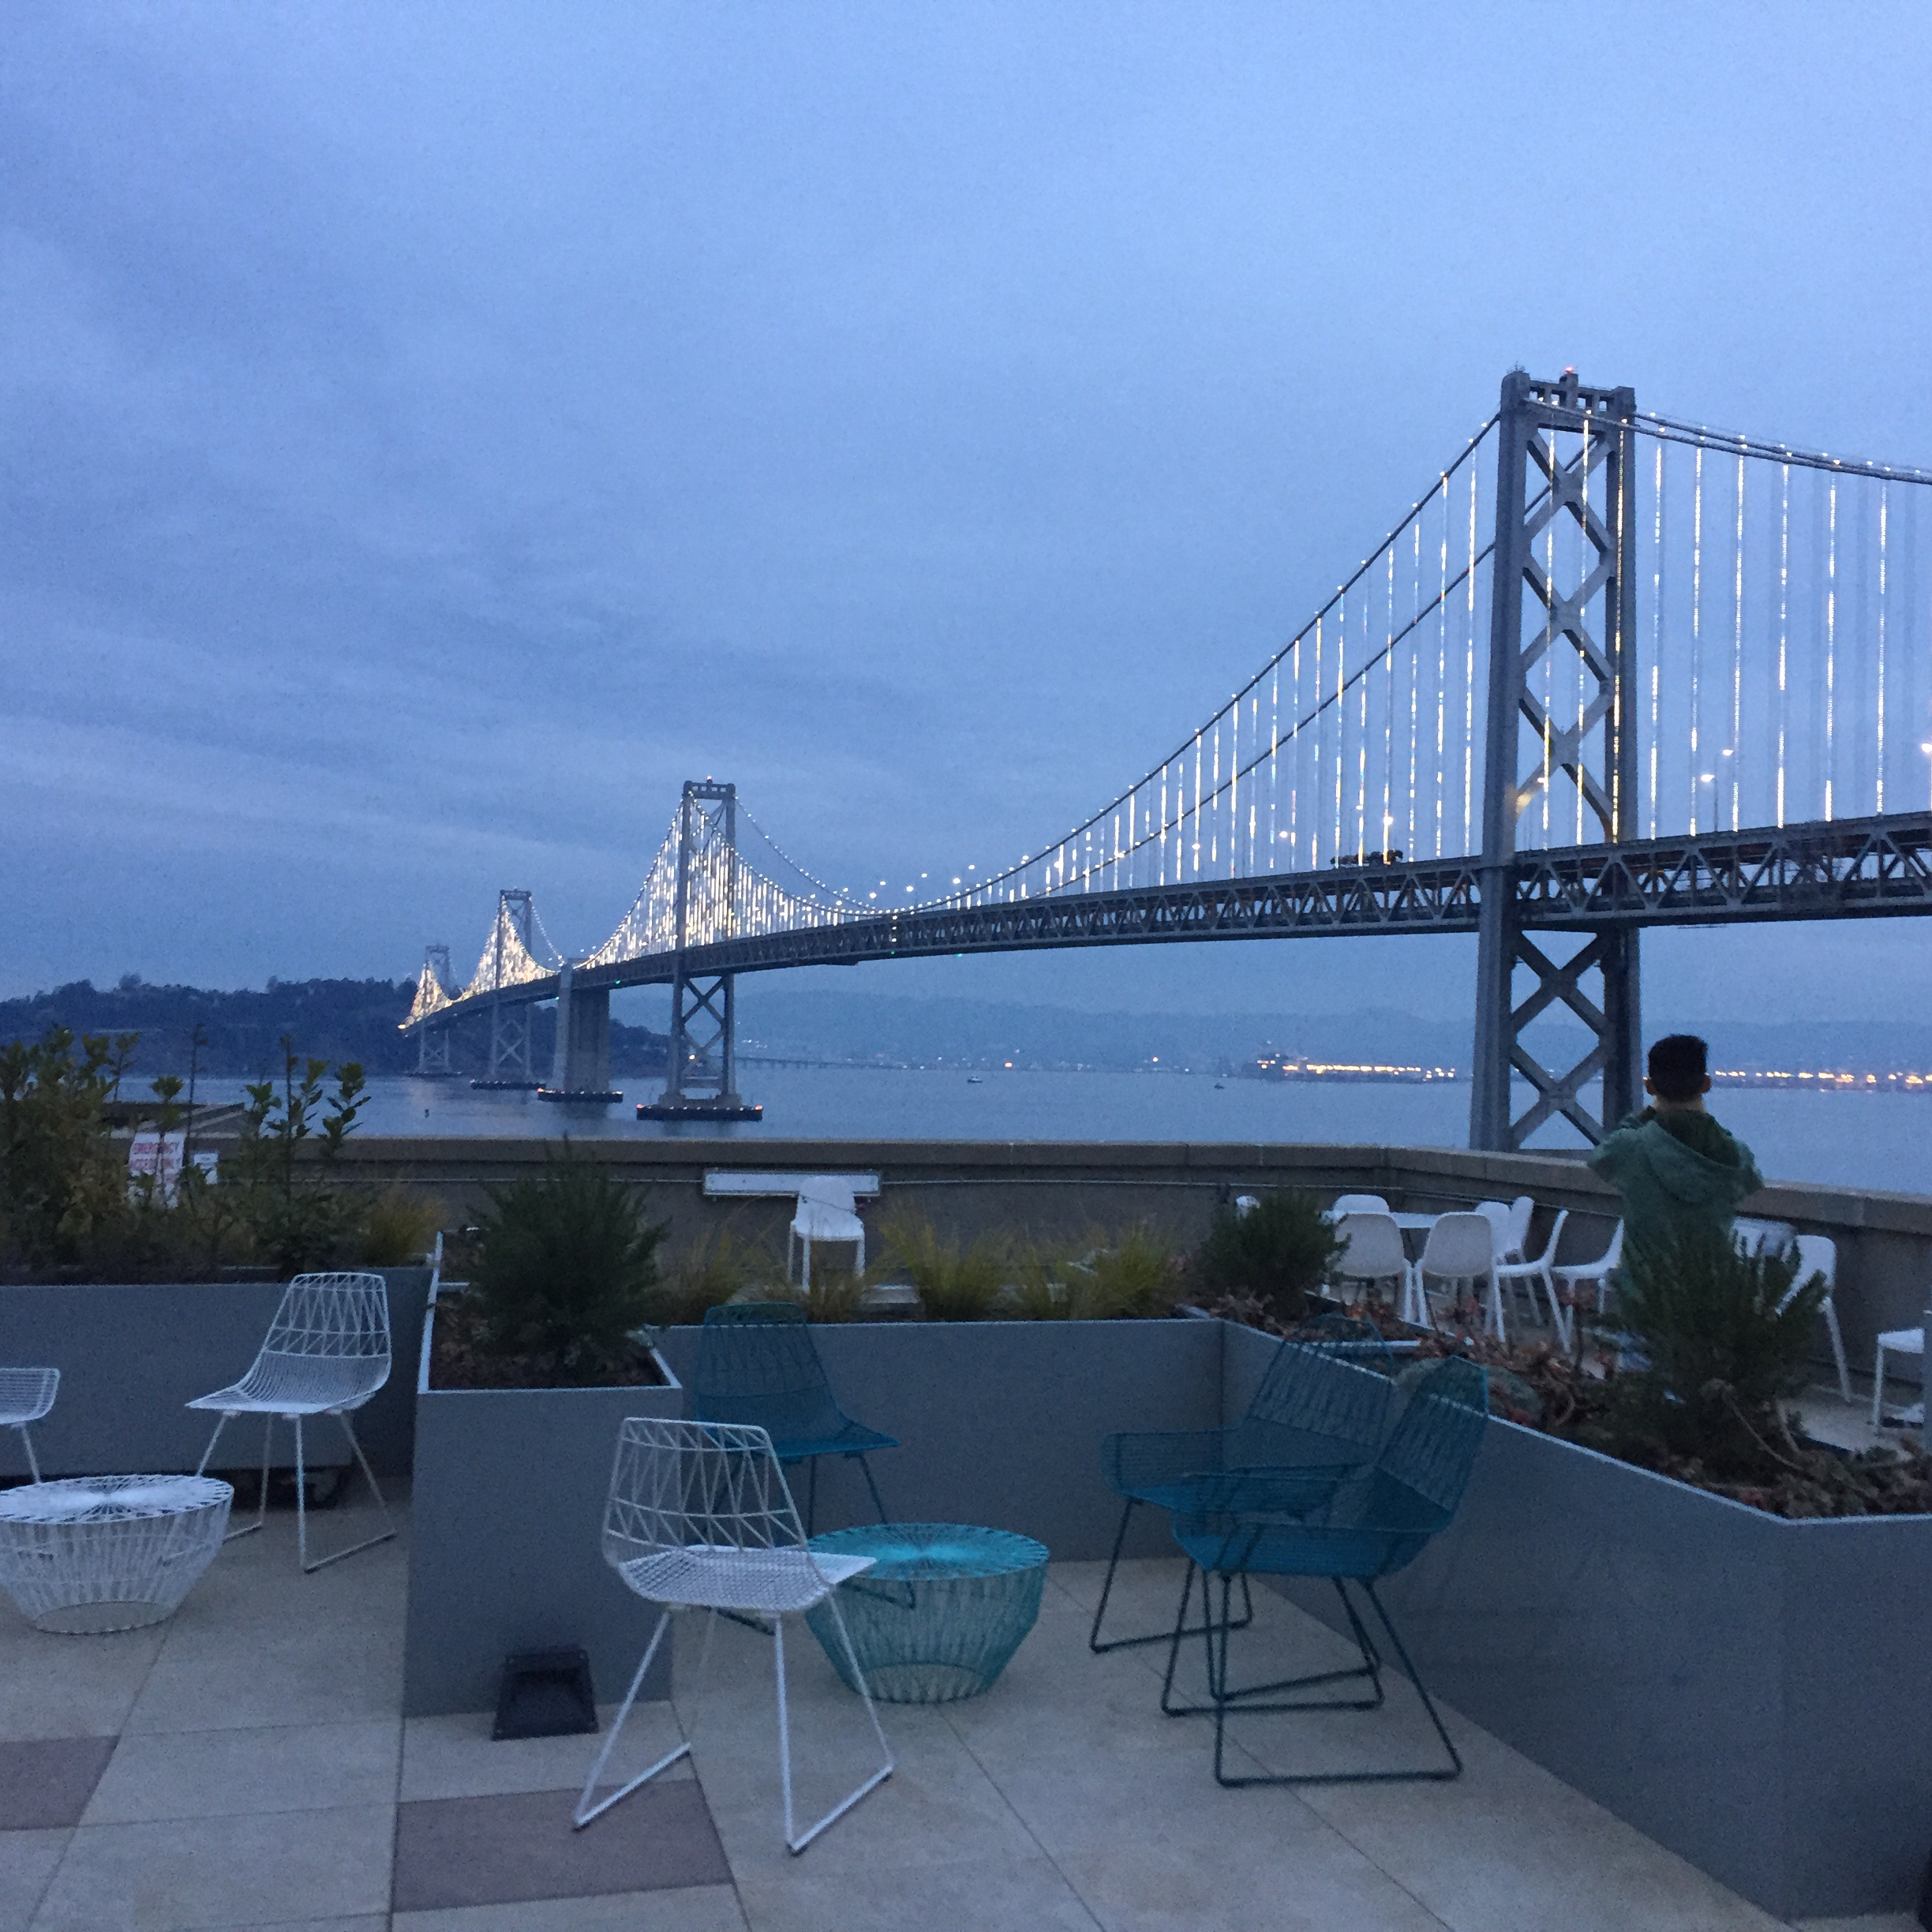
Hyperparameters: Style:Content Weight Ratio
Considering the soft textures of our style features
α/β ratio: Original Implementation 10e-4 (left), 10e-6(right)

Slide 6
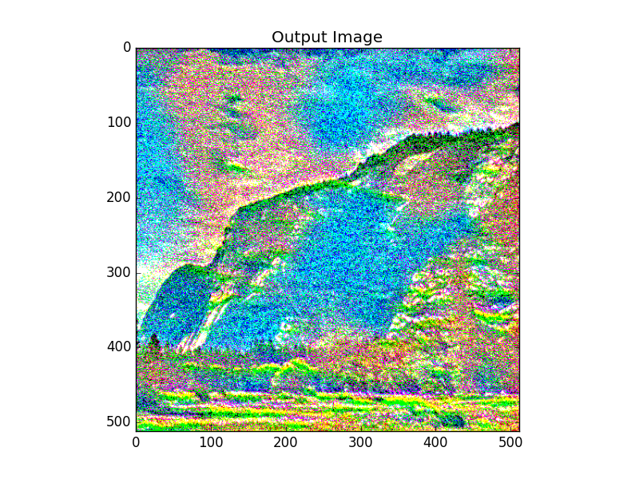
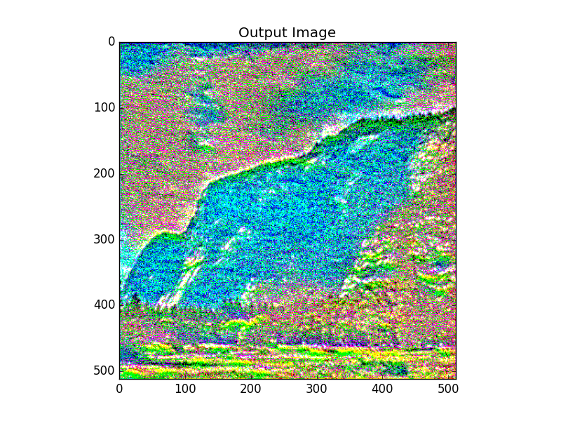
Hyperparameters: Input Image and Pooling Type
Original Implementation: Replaced max pooling with average pooling, feeding in white noise image
Average pooling with input image as content_img (left) and white_noise_img (right)

Slide 7
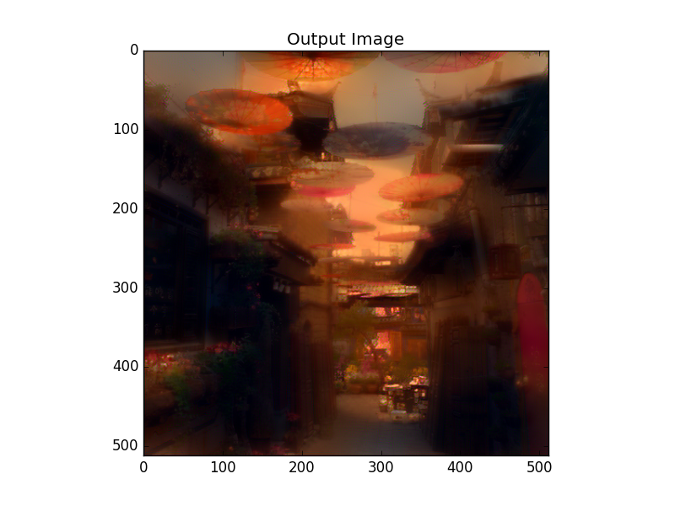
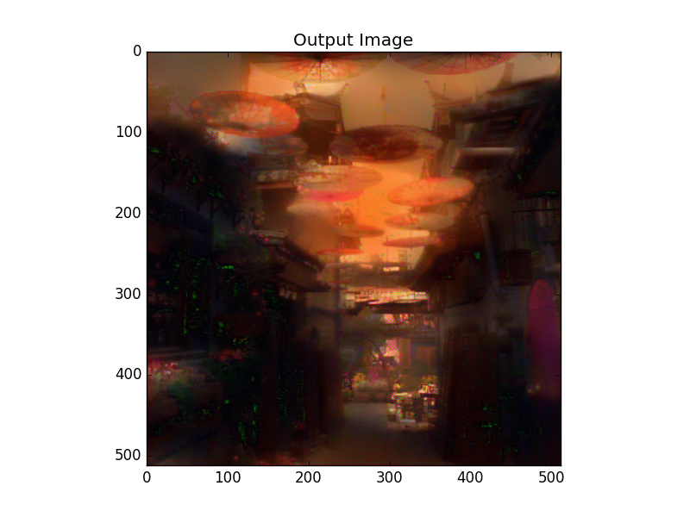
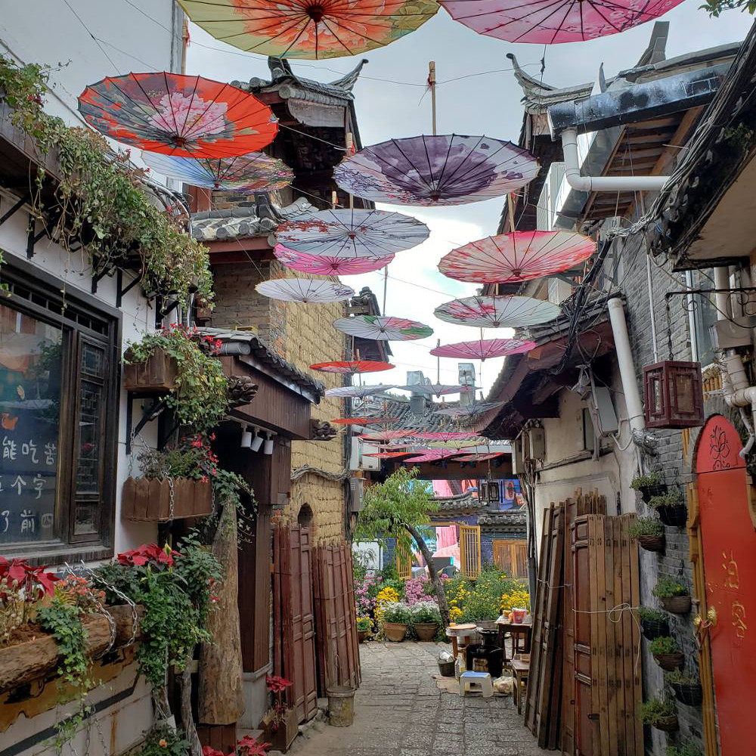
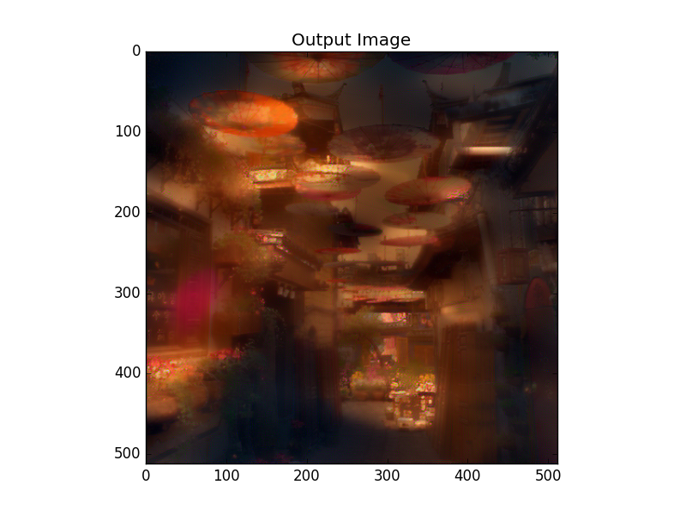
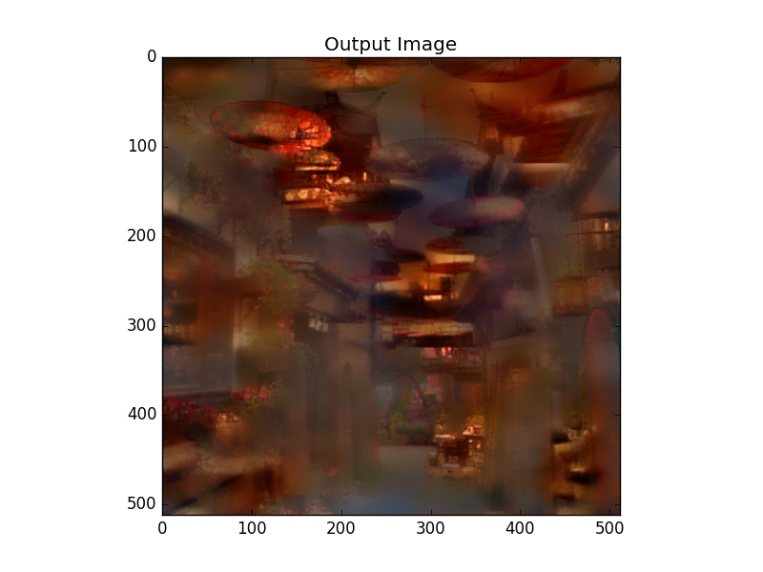
Input image: content_img, 300 (left) & 500 (right) steps
Input image: white_noise_img, 500 (left) & 1000 (right) steps

Slide 8
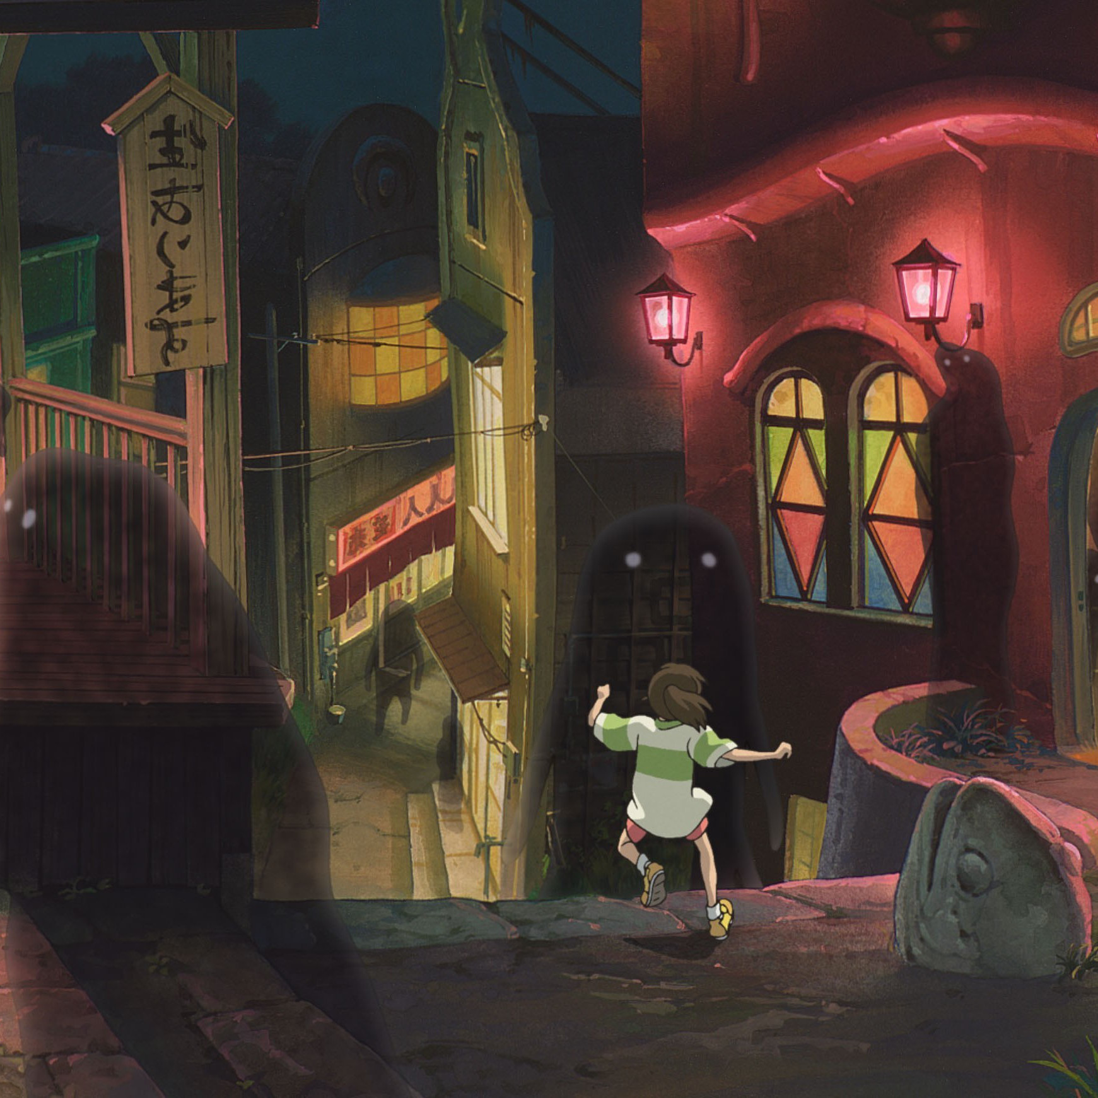
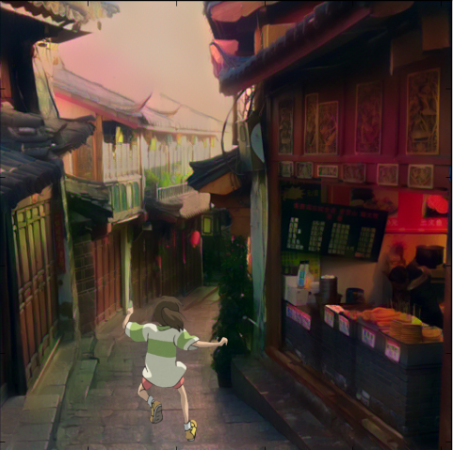
The Good…

Slide 9
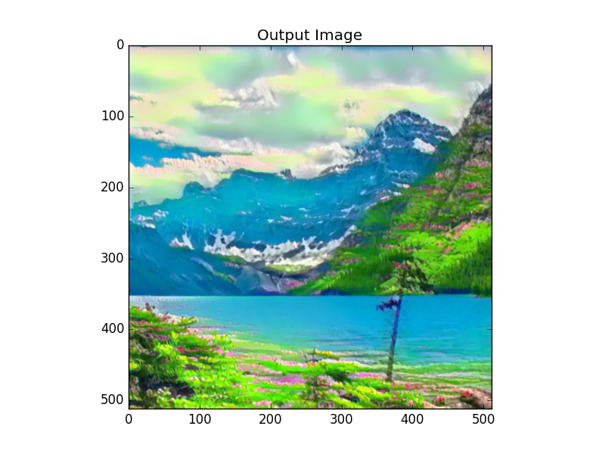
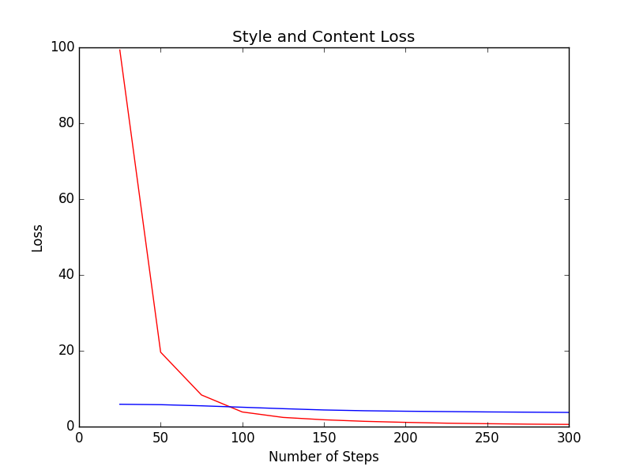
The Good…

Slide 10
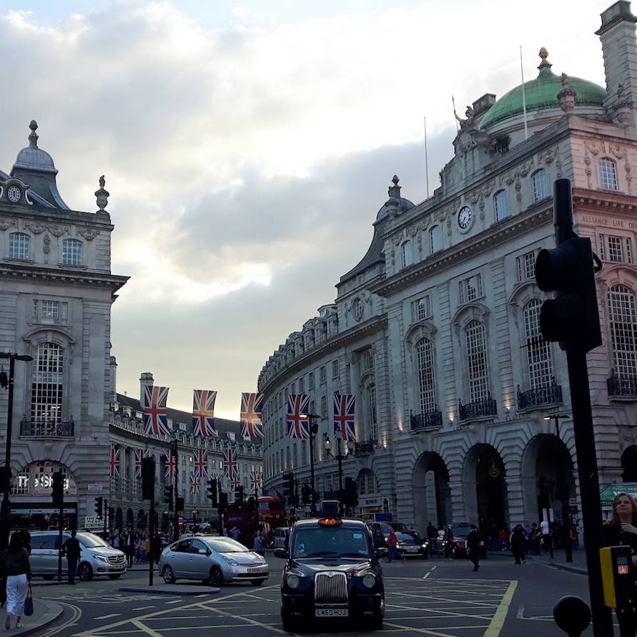
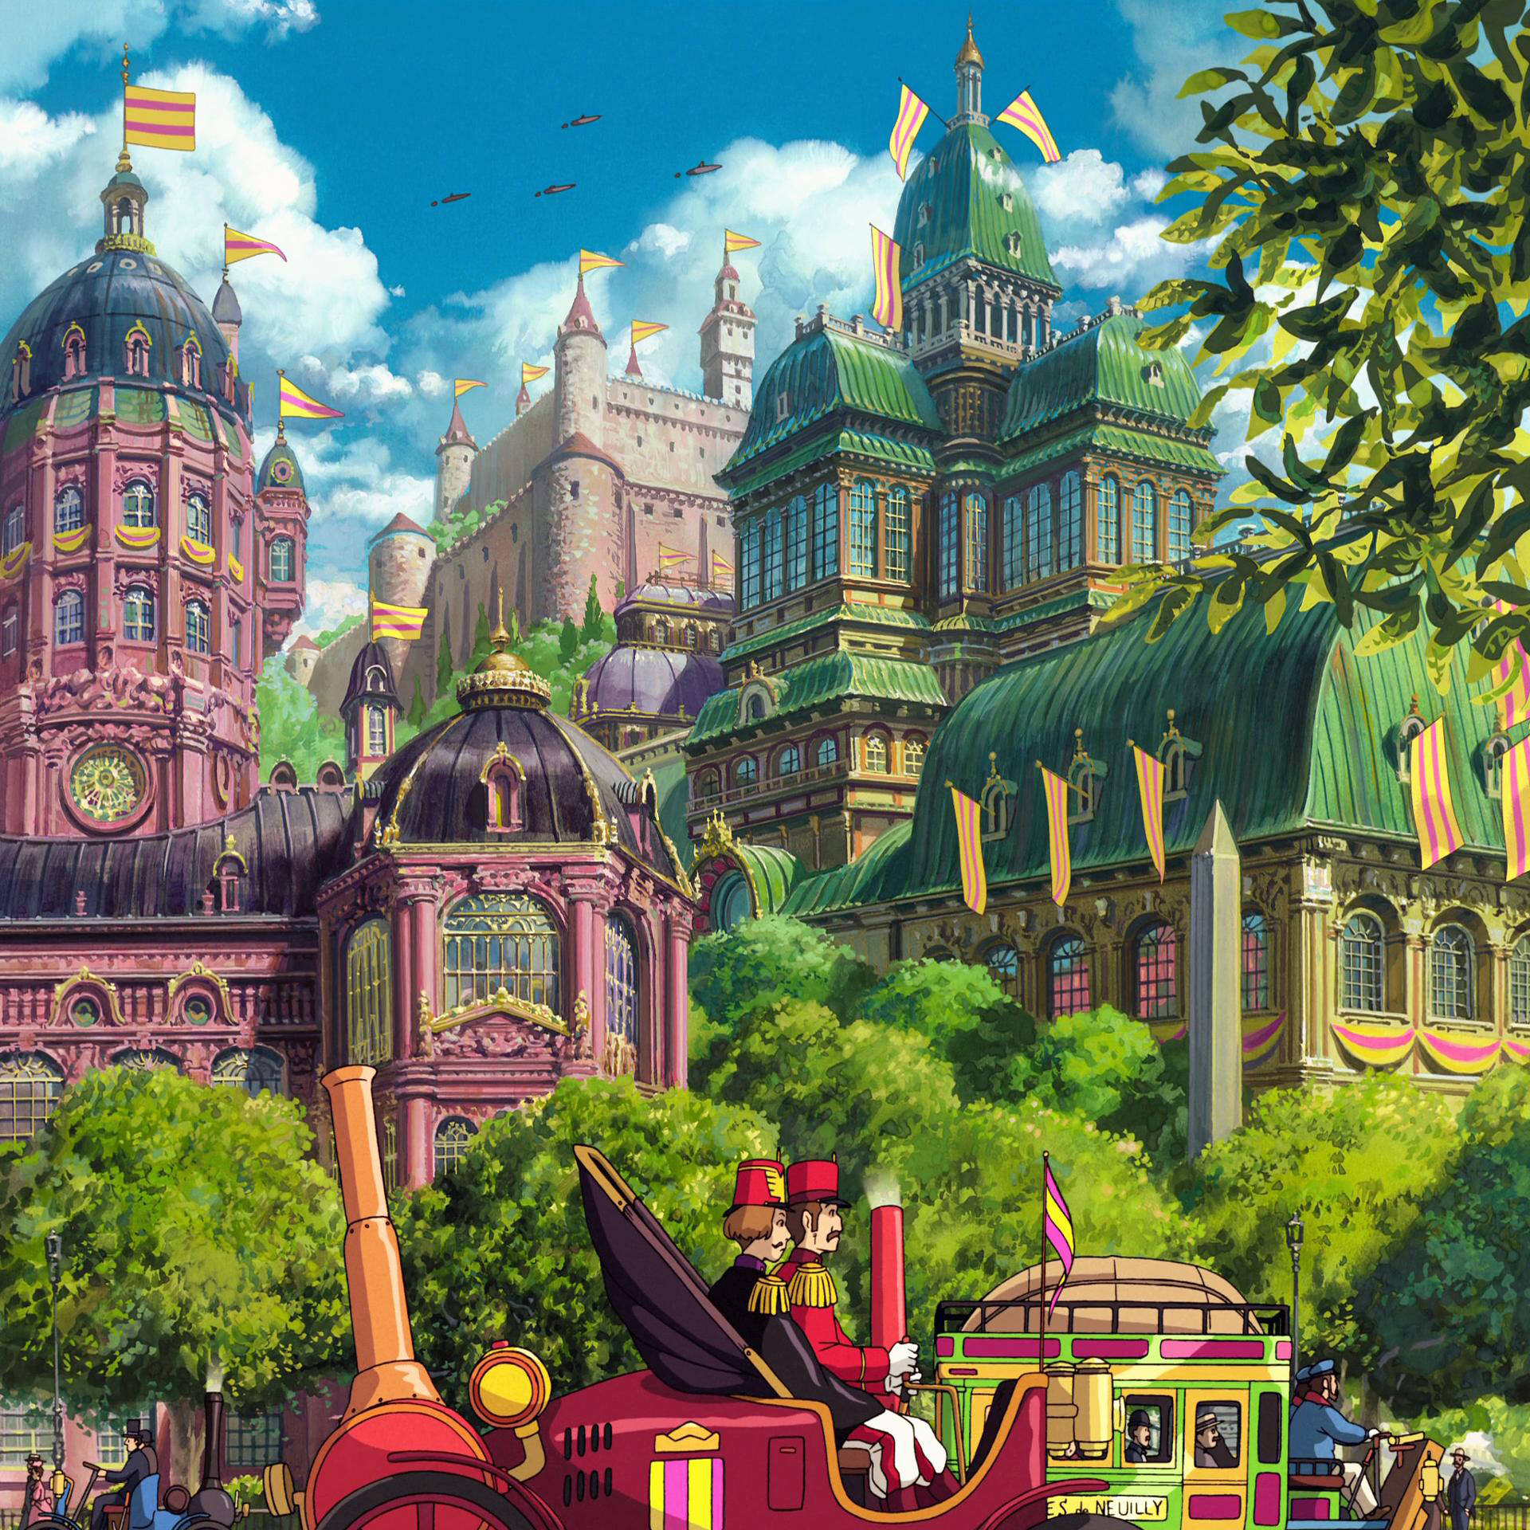
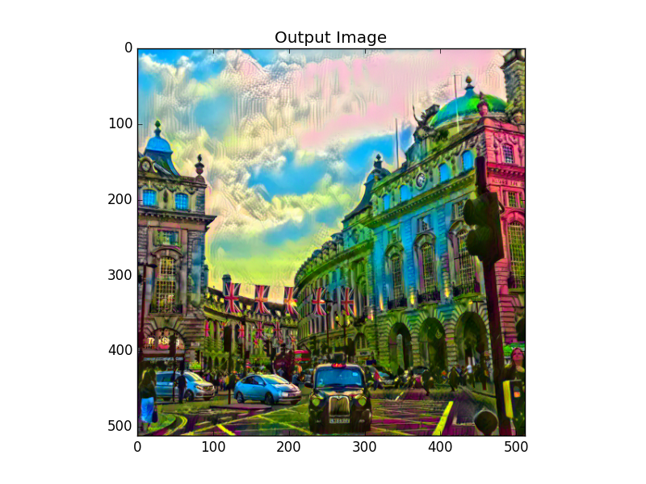
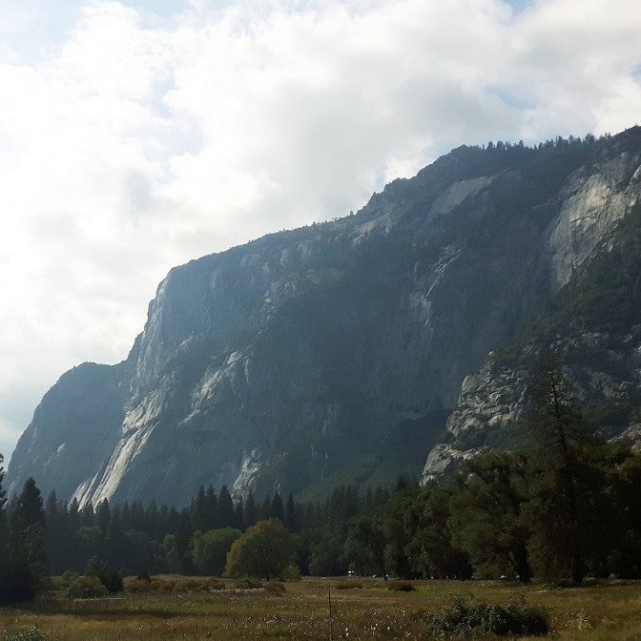
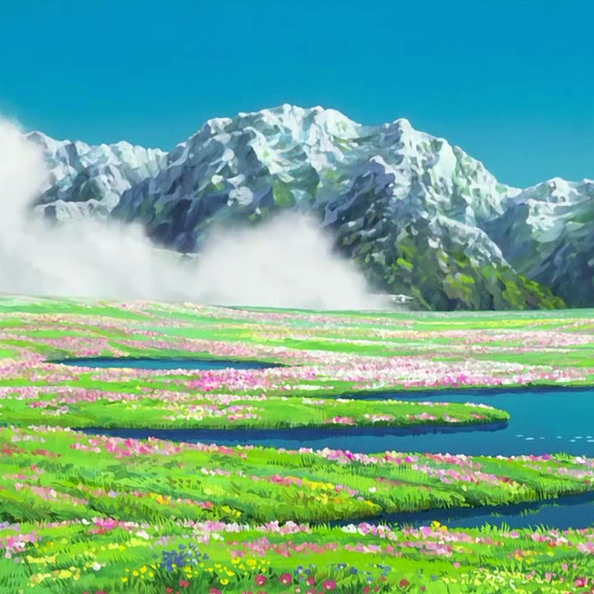
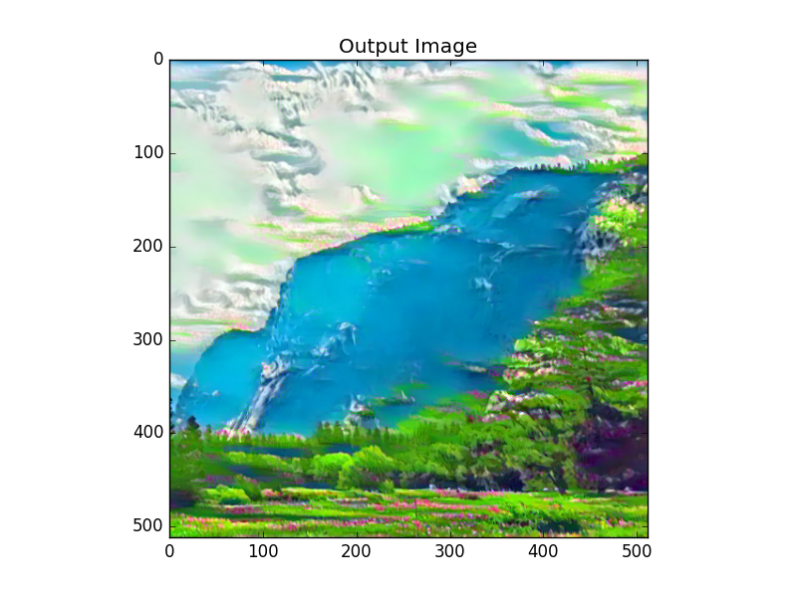
The Ugly…
Undesired regions from style image ‘bleed’ into output

Slide 11
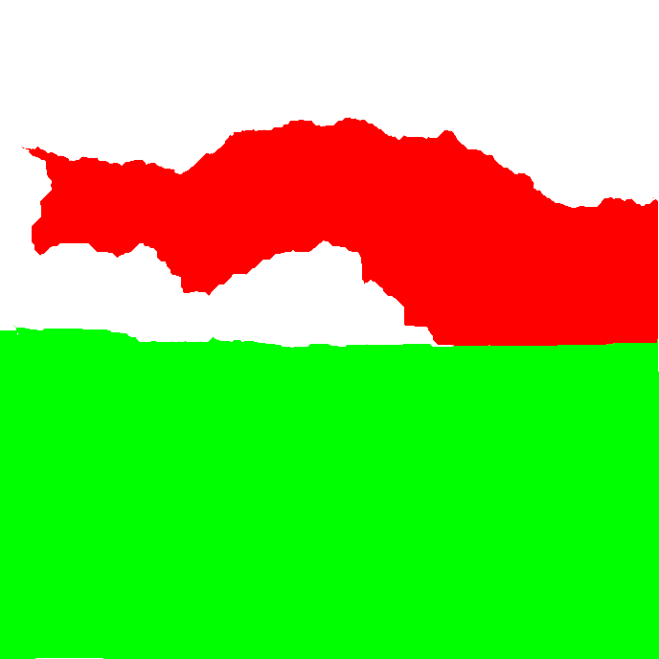
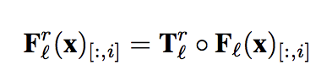
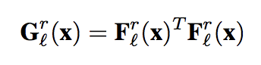
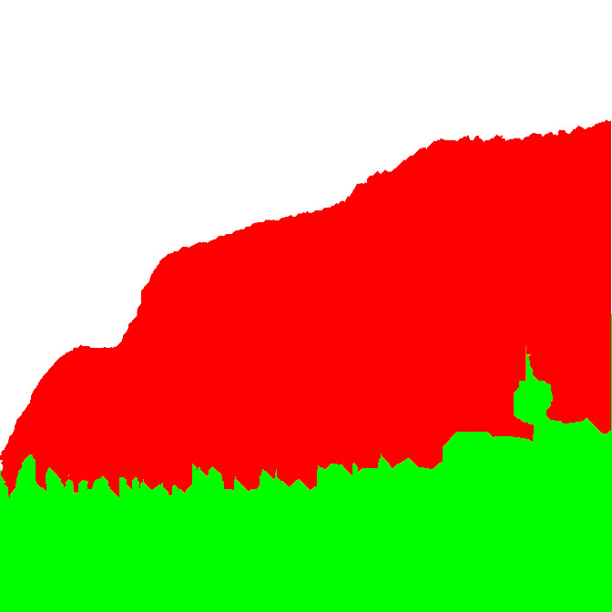
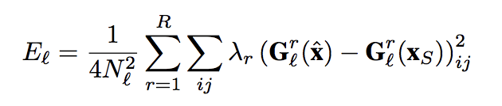
Future Implementations
Semantic Style Transfer – Segmentation Masks
Guided Gram Matrices – Incorporating spatial guidance channels
Gatys et al. (2016). Controlling Perceptual Factors in Neural Style Transfer.
Other Possibilities:
Training a model based on Studio Ghibli movie frames
CycleGANs (refer to CartoonGAN - Generative Adversarial Networks for Photo Cartoonization

Slide 12
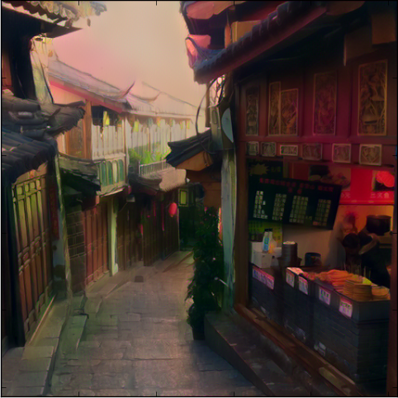
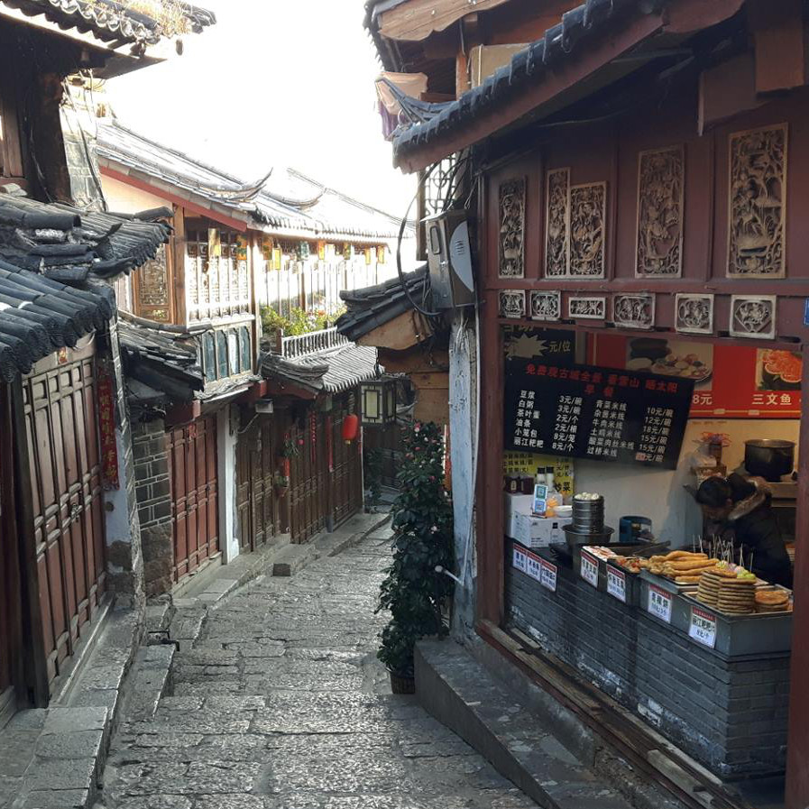

Slide 13
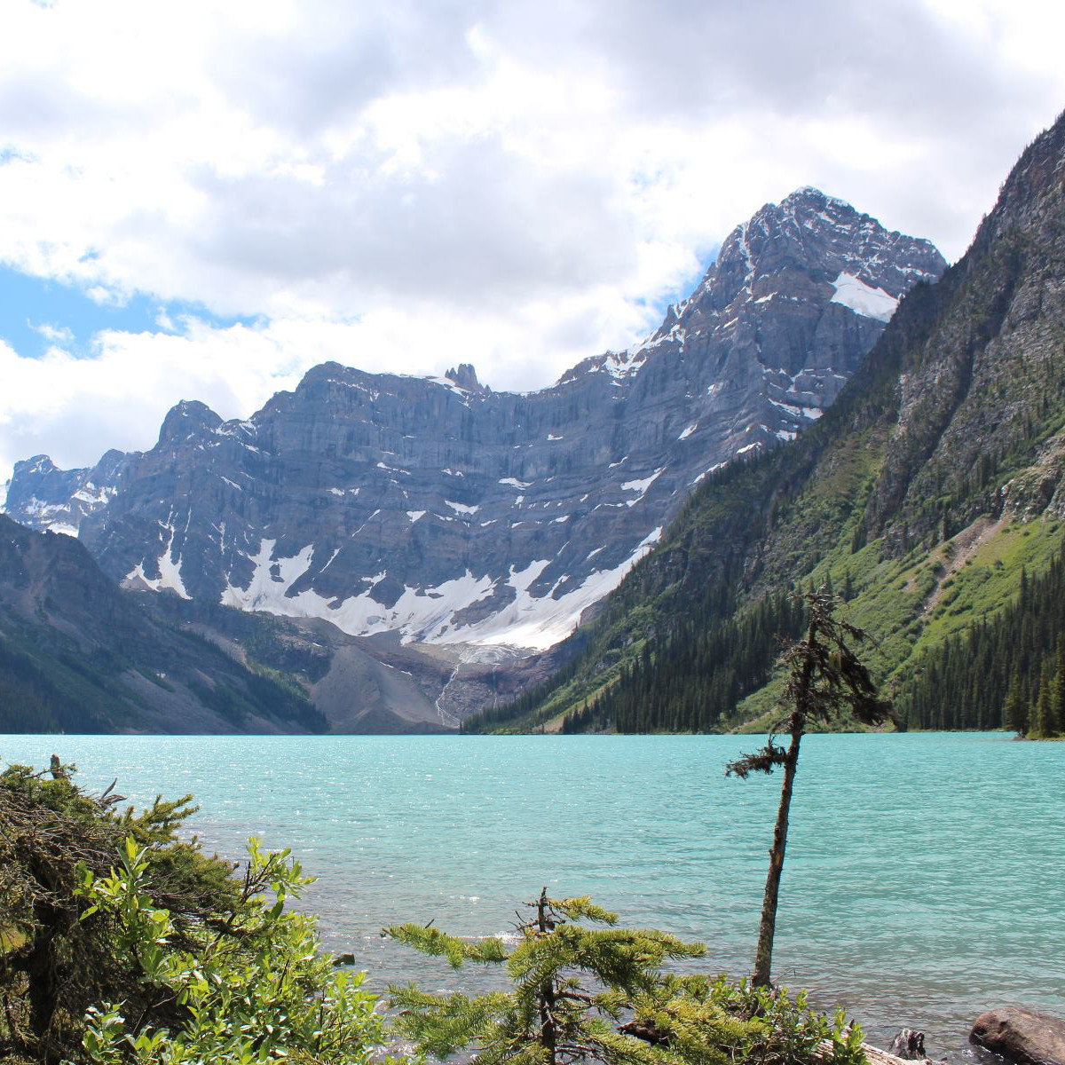

Slide 14
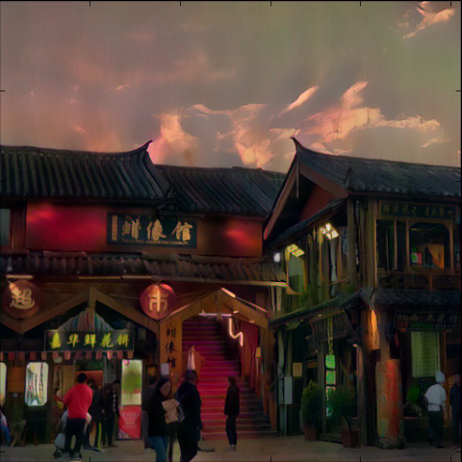
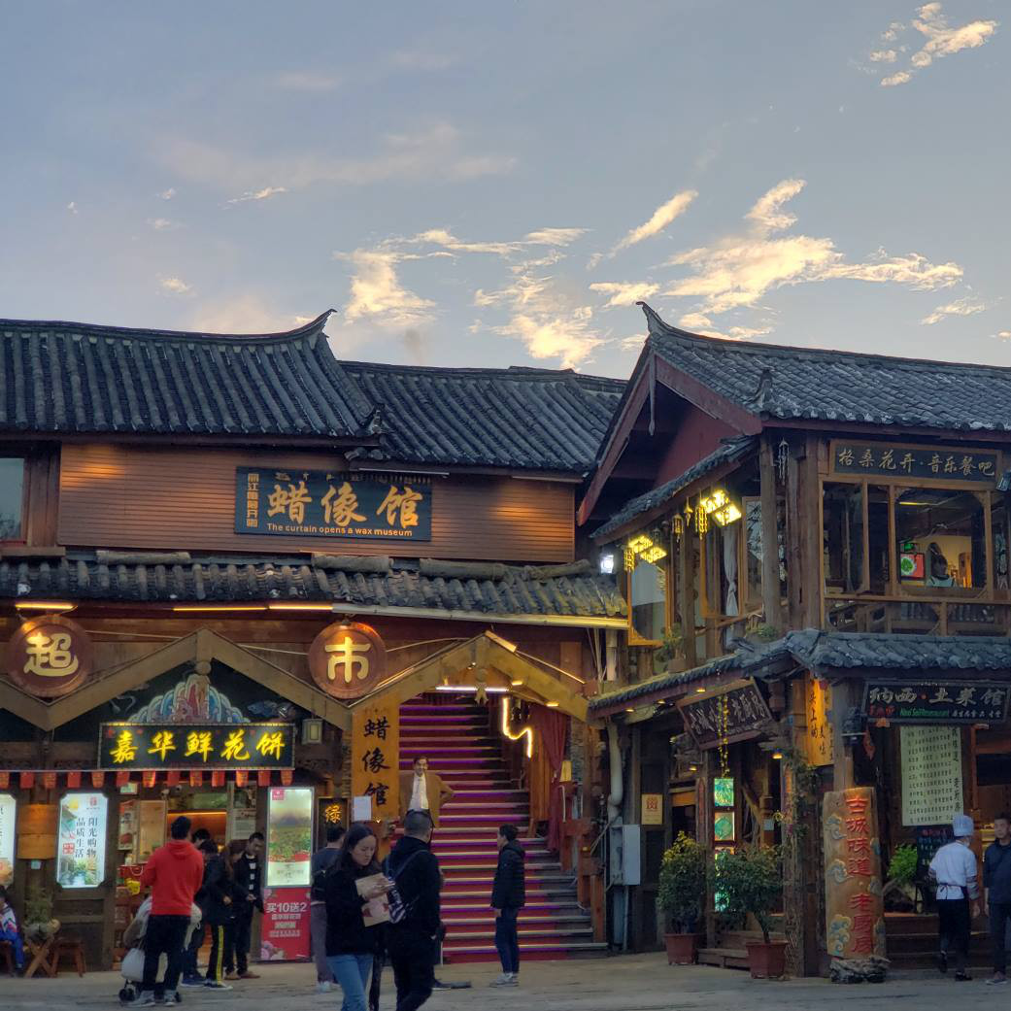

Slide 15
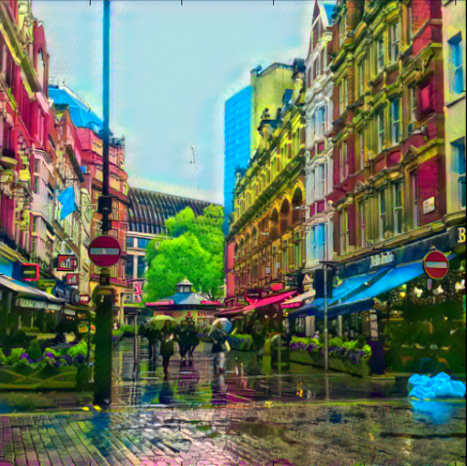
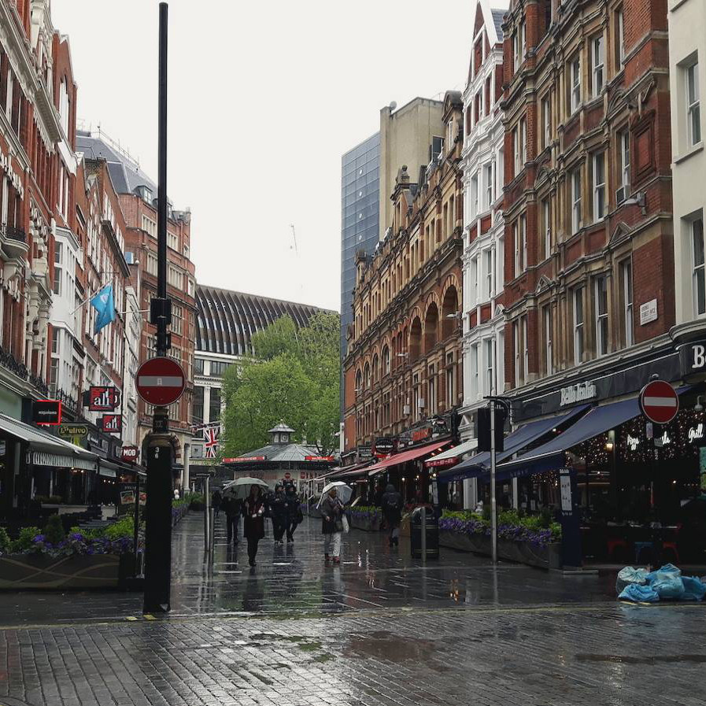

Slide 16
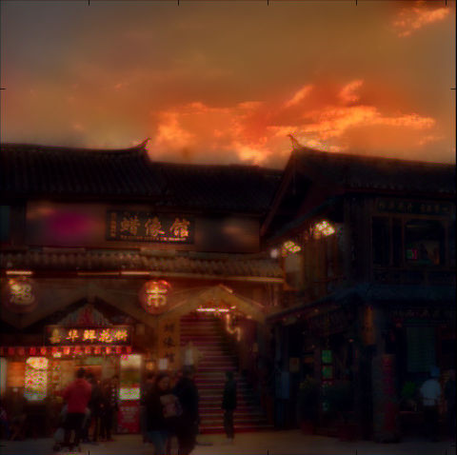

Slide 17
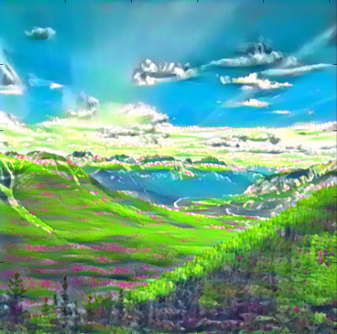
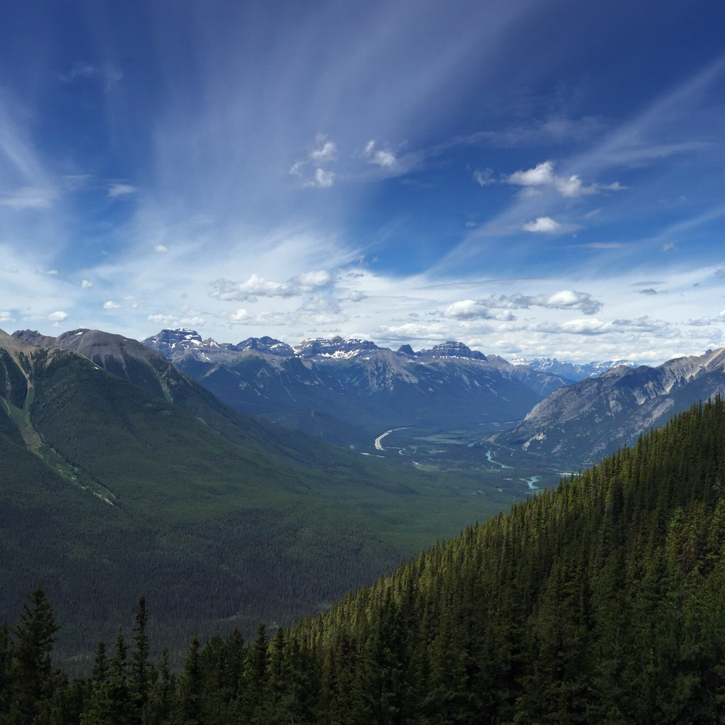

Slide 19
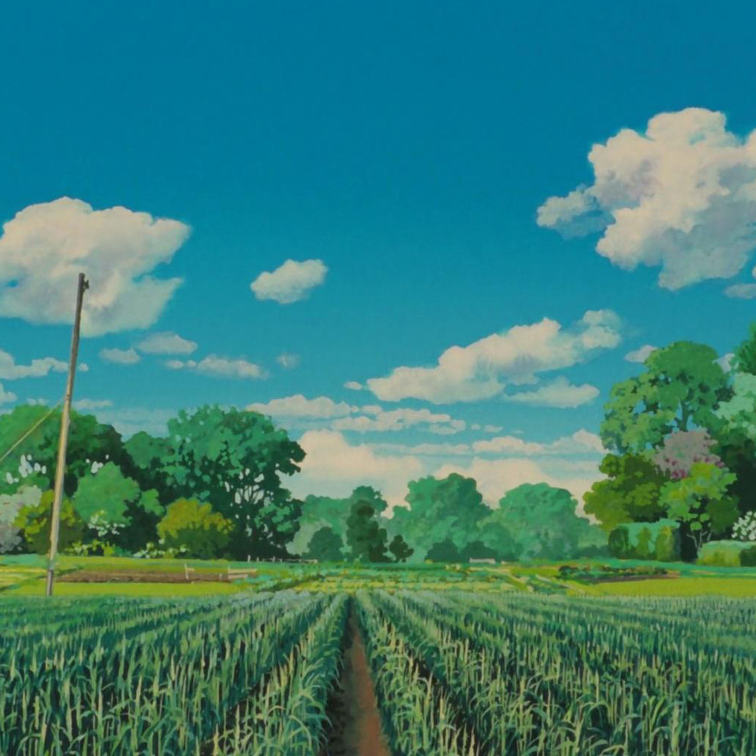
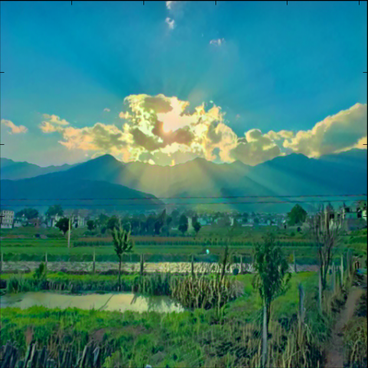
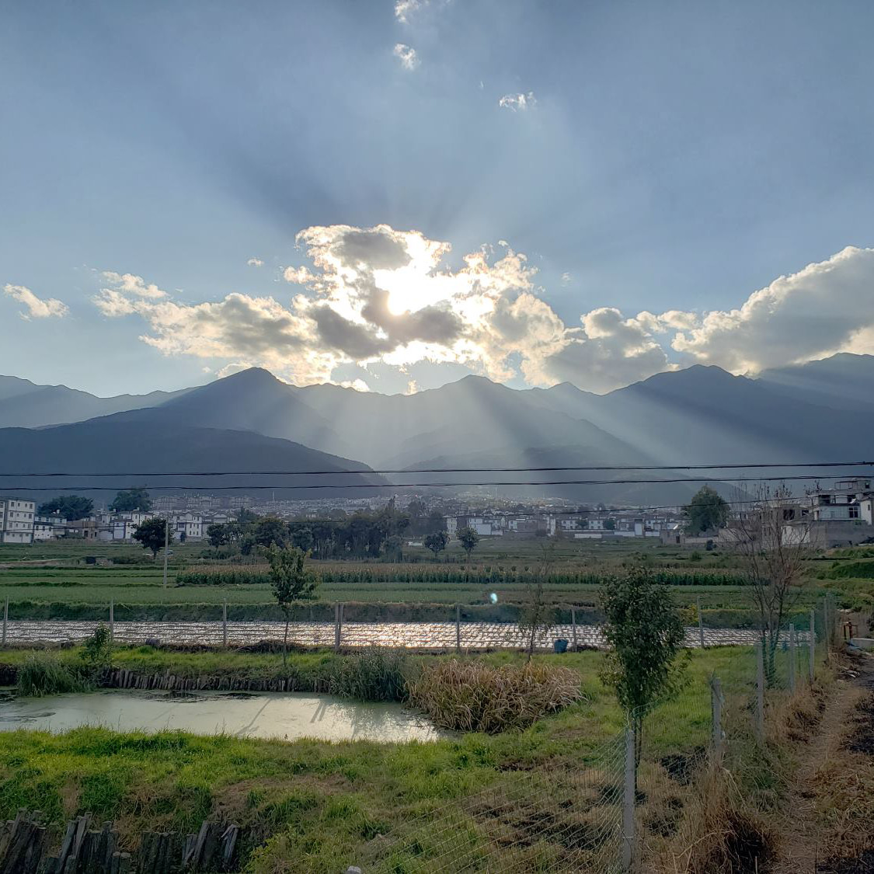

Slide 20
